Slide 1
Formatting and Style
Module 2

Slide 2
HTML Headings

Slide 3
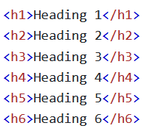
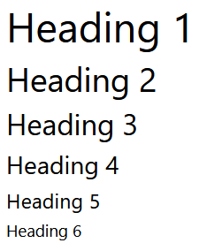
Headings
Headings are defined with the <h1> through <h6> tags
We generally use h1 headings for the most important heading on a page
We generally use h6 headings for the least important heading on a page

Slide 4
Headings are Important
People tend to skim web pages for the information they care about
We can divide our pages into their content by using headings
Headings help tell search engines like Google what is in your web page
Notes:
It is a bad practice to use more than one of each type of heading per page.

Slide 5
Bigger Headings
All headings have a default size, but they can be changed using the style attribute
It’s better to do this in a CSS file unless you have a specific reasoning.

Slide 6
HTML Paragraphs

Slide 7

Paragraphs
<p> elements define a paragraph
Paragraphs always begin on a new line
Your browser will add a small margin around each paragraph element

Slide 8
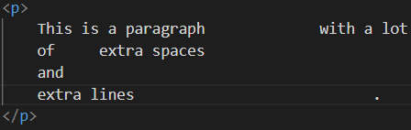

Display
We never know exactly how our HTML code will be displayed until we run it
Even using the same HTML doc, your laptop will display things differently than your phone
Your browser will ignore any extra spaces or lines that you add

Slide 9

Line Breaks
<br> elements are line breaks
You can use line break elements to start a new line without creating a new paragraph (or other element)
<br> tags are empty, meaning they have no content or end tag

Slide 10
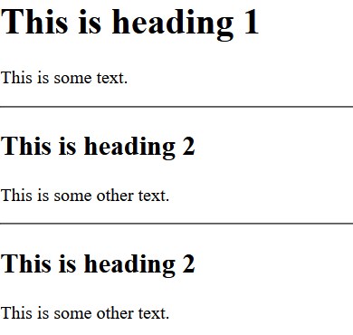
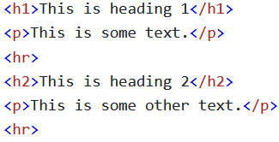
Horizontal Rules
A horizontal rule element (<hr>) creates a thematic change in a doc
<hr> elements are used to separate content or show a change in content on an HTML page
Just like <br> elements, <hr> tags are empty, meaning they have no end tag

Slide 11
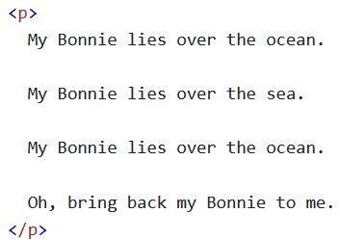
The Poem Problem
If you tried to write a poem inside of a <p> element, it would not format it the way you wrote it
Poems need their formatting to be read correctly
How do we write a poem then?

Slide 12
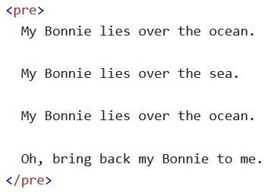
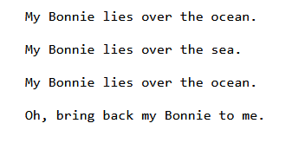
The Poem Problem
The <pre> element creates pre-formatted text
All extra spaces and lines will be kept, unlike other elements

Slide 13
HTML Styles

Slide 14
The Style Attribute
We can change any CSS property of an element using the style attribute
Styles all use the syntax of CSS

Slide 15
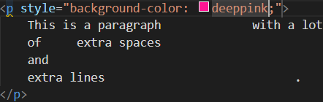

Background Color
The CSS background-color property defines the background color for an HTML element

Slide 16


Text Color
The CSS color property allows you to set the font color of an element

Slide 17

Font
The CSS font-family property allows you to set the font for an element

Slide 18
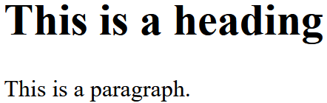
Font Size
The CSS font-size property allows you to set the font size of an element
Note: So far we have only used pixels, but there are many units in CSS

Slide 19

Text Alignment
The CSS text-align property allows you to decide which horizontal text alignment an element uses
There are several values of text-align

Slide 20
HTML Formatting

Slide 21
HTML Formatting Elements
There are several formatting elements designed to display special types of text
<b> - Bold text
<strong> - Important text

Slide 22
HTML Formatting Elements
<i> - Italic text
<em> - Emphasized text (similar to <i>, but screen readers pronounce them differently)
<mark> - Marked text

Slide 23
HTML Formatting Elements
<small> - Smaller text
<del> - Deleted text
<ins> - Inserted text

Slide 24
HTML Formatting Elements
<sub> - Subscript text
<sup> - Superscript text

Slide 25
HTML Quotations

Slide 26
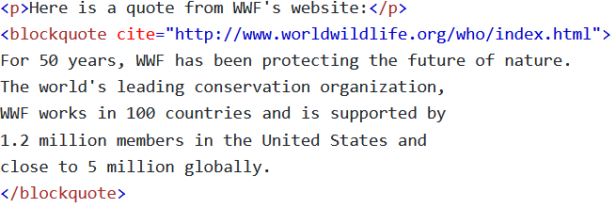
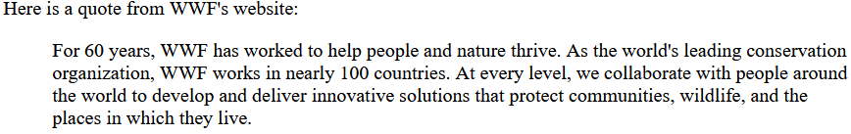
HTML <blockquote> for Quotations
<blockquote> elements are quoted from another source
These generally get indented by your browser

Slide 27
HTML <q> for Short Quotes
A <q> element creates a short quotation
Your browser will usually stick quotes around these

Slide 28

HTML <abbr> for Abbreviations
The HTML <abbr> tag defines an abbreviation or an acronym like “HTML”, “CSS”, or “JS”
Creating <abbr> elements gives helpful information to browsers, search engines, and translation systems
You can use the title attribute to show the description of an acronym when you mouse over an element

Slide 29
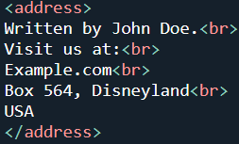
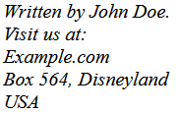
HTML <address> for Contact Info
An <address> element specifies contact info for an owner/author of a document or an article
You can have any type of contact info inside of an <address> element
Everything inside of the element will be italicized

Slide 30

HTML <cite> for Work Title
<cite> elements are used for the title of some type of art, like a painting, song, book, film, etc
When you use a <cite> element, you only include the title of the piece, not the artist’s name

Slide 31
HTML <bdo> - Bi Directional Override
The <bdo> element is used to override the direction the text is written in

Slide 32
HTML Comments

Slide 33
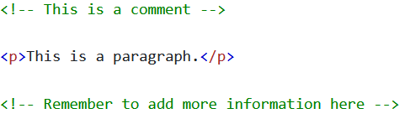
Comment Tags
You can write comments in your code that do not get displayed, but can help other programmers understand what is going on in your code
Comments are used for documentation and debugging

Slide 34
HTML Colors

Slide 35
Colors
Colors are used with the style attribute for giving individual elements are style
There are many ways to express a color

Slide 36
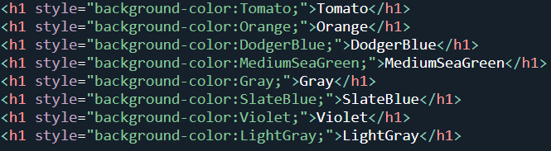
Color Names
In HTML, colors can be specified using a color name
There are over 140 colors that can be referred to by name, but there are many more than 140 color available

Slide 37
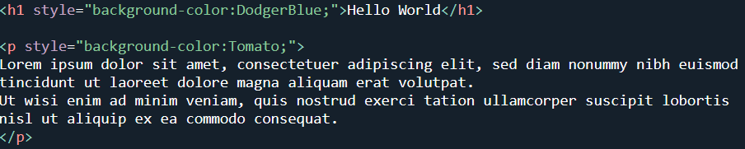
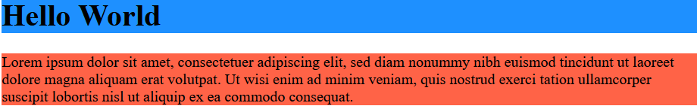
Background Color
Background color allows you to set the background color
Note: background color has a shorthand property: background
This lets you set multiple background properties in a single line

Slide 38
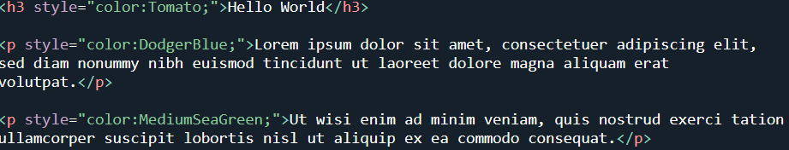
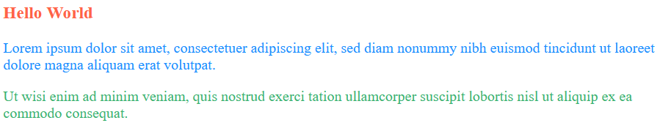
Text Color
The color property allows you to change text’s color
All color properties support all ways to represent a color

Slide 39
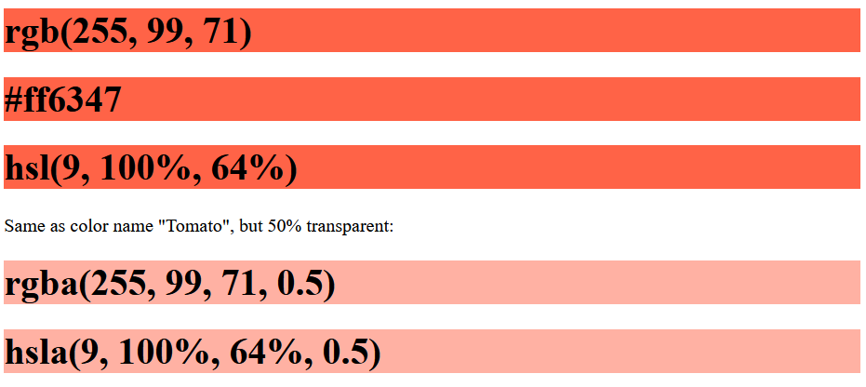
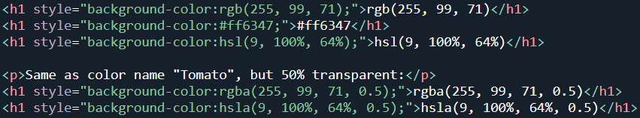
Color Values
Colors can be represented using RGB, RGBA, HEX, HSL, and HSLA values
Every color can be represented using any of these options
RGBA and HSLA both allow you to control the transparency of a color

Slide 40
RGB Colors

Slide 41

RGB Color Values
In HTML, a color can be specified as an RGB value using the following formula: rgb(red, green, blue)
Each parameter (red, green, and blue) define the intensity of the color with a value between 0 and 255 (one byte)
Using 3 bytes (256^3), we can create 16,777,216 colors

Slide 42

RGB Color Value
You can create white or black by assigning all colors a 0 (black) or 255 (white)
You can create shades of gray by setting all three color values to the same number
Try it out on W3Schools!

Slide 43

RGBA Color Values
RGBA is RGB with an added Alpha value, which allows you to change the opacity of the color
The alpha value ranges from 0 (fully transparent) to 1 (not transparent at all)
Try it out on W3Schools!

Slide 44
HEX Colors

Slide 45

Hex Colors
Colors can also be represented in hexadecimal form
Hexadecimals are base 16 (0 – f), so you can use two characters to represent a number (16^2 = 256)
They follow this pattern: #rrggbb
Notes:
Apart from using a different base, they work exactly the same as RGB values

Slide 46

Hex Colors
Ex: #ff0000 is red, since ff is the same as 255 (pure red in RGB) and every other value is 0
You can create black using #000000 and white using #ffffff
You can create shades of gray using equal values for each of the three parameters (#aaaaaa)

Slide 47
HSL Colors

Slide 48
HSL Color Values
Another way to create a color is using HSL – Hue Saturation Lightness
Hue: A degree on the color wheel from 0 to 360
0 – Red
120 – Green
240 – Blue

Slide 49

HSL Color Values
Saturation: a percentage value where 0% is a shade of gray and 100% is the fullest version of that color
Lightness: a percentage value ranging from black (0%) to white (100%)

Slide 50


Saturation
Saturation is the intensity of a color
100% is the pure color (0% gray)
50% is 50% gray and 50% of the color
0% is completely gray – the color is not visible

Slide 51


Lightness
The lightness of a color how much light the color has
0% lightness – no light (black)
50% lightness – neither light nor dark
100% lightness – full lightness (white)

Slide 52


HSL Grays
You can create shades of Gray by setting the Hue and Saturation to 0, but adjusting the lightness

Slide 53

HSLA Color Values
HSLA values are HSL with an Alpha value, which specifies an opacity
Just like with RGBA, Alpha runs from 0 to 1, with 0 being fully transparent and 1 being fully opaque

Slide 54
HTML CSS

Slide 55
What is CSS?
Cascading Style Sheets (CSS) is a stylesheet language used to format/style a webpage
CSS allows you to convert an HTML page to a beautiful, modern website by altering the positioning, margins, font, colors, and more
We’ll have an entire third of the class that covers nothing but CSS once we complete HTML

Slide 56
Using CSS
We can add CSS to HTML Documents in 3 ways:
Inline – using the style attribute inside of our HTML elements
Internal – using a <style> element in the <head> section
External – using a <link> element to link an entire CSS file (this is generally the best way)

Slide 57

Inline CSS
Inline CSS applies a unique style to a single element
This always works using the style attribute

Slide 58
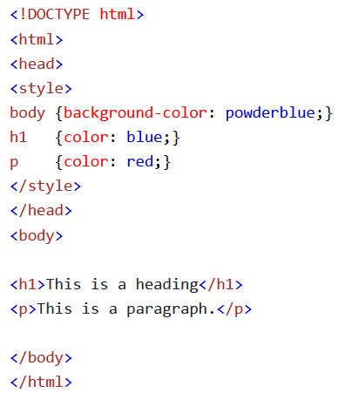
Internal CSS
Internal CSS is used to define a style for a single HTML page
You create a <style> element within the <head> element and then write your CSS code directly inside of the <style> element

Slide 59
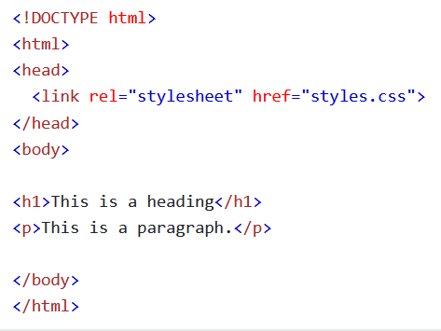
External CSS
External stylesheets are used to define the styles for many HTML pages
These are the preferred way to style an HTML page since they allow you to reuse your styles as many times as possible
You can link your external CSS file by using a <link> element in the <head> of an HTML page

Slide 60
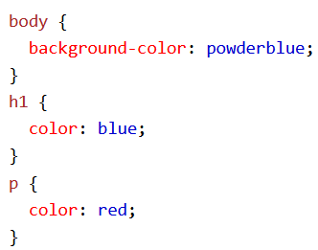
External CSS
The external stylesheet cannot contain any HTML code and must have the extension .css

Slide 61
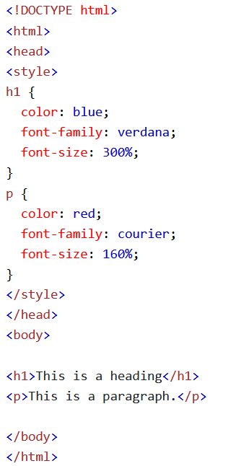
CSS Colors, Fonts, and Sizes
The CSS color property defines the color of the text
The CSS font-family property defines the font to be used
The CSS font-size property defines the font size to be used

Slide 62

CSS Border
The border property creates a border around an HTML element
Nearly all elements can use a border
Note: border is a shorthand property that can set border-style, border-width, and border-color all in the same step

Slide 63
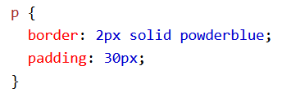
CSS Padding
The padding property defines a padding (space) between the text of an element and its border

Slide 64
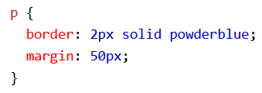
CSS Margins
The margin property defines the margin (space) outside of the border

Slide 65
Link to External CSS
External stylesheets can be referenced using a full URL or a relative path

